Slide 1
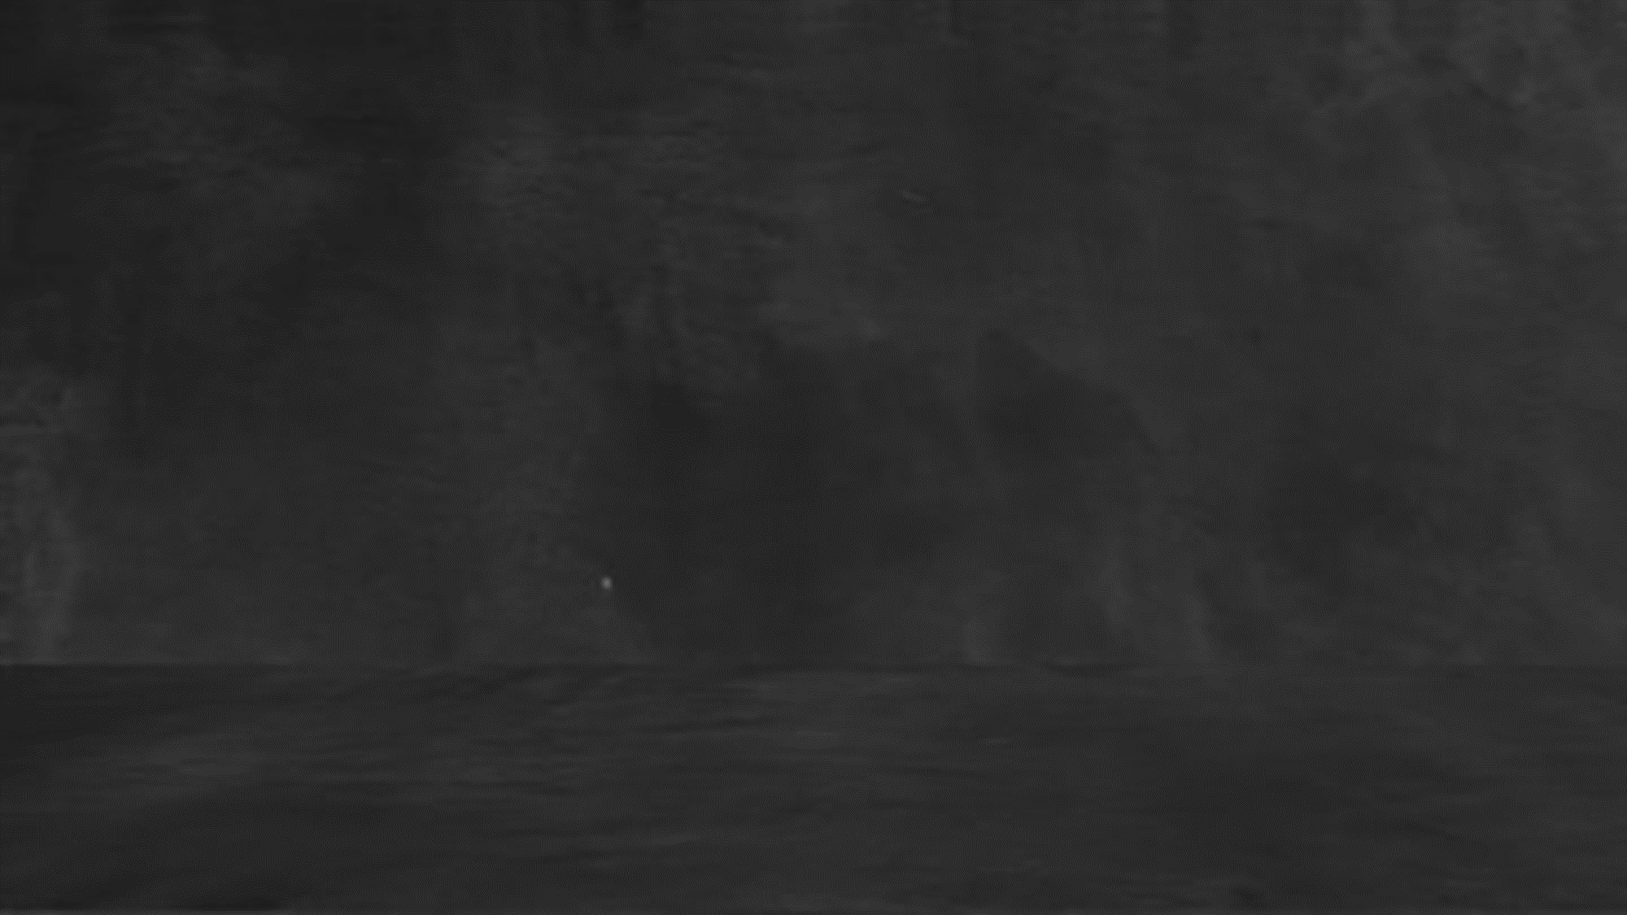
#BestEver
10th
Science-2
Prelims Exam
महाPractice
Maharashtra Board

Slide 2
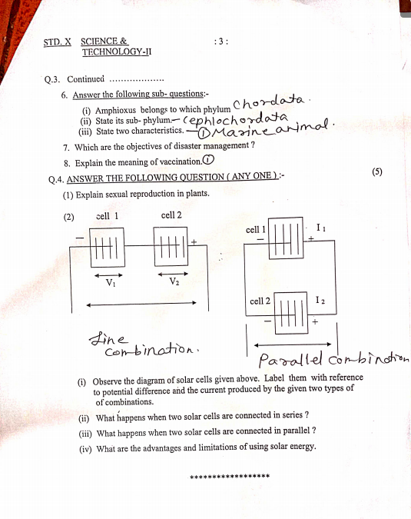
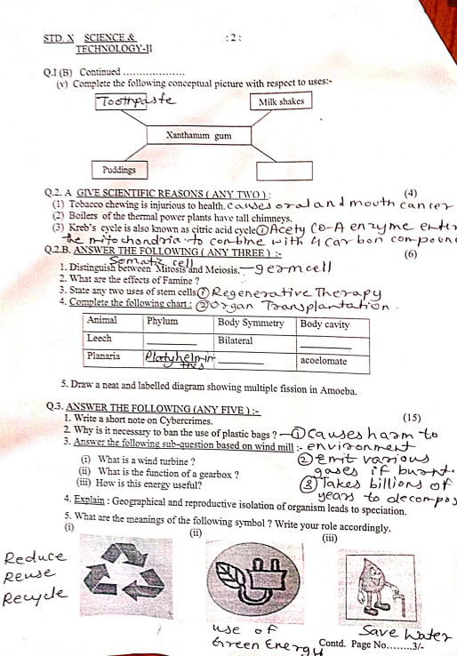
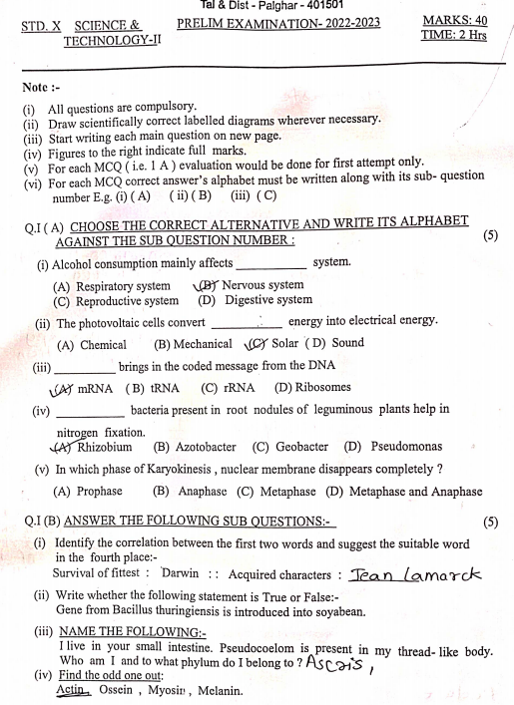
Let’s Solve with
Crystal concept
SUBSCRIBE

Slide 3
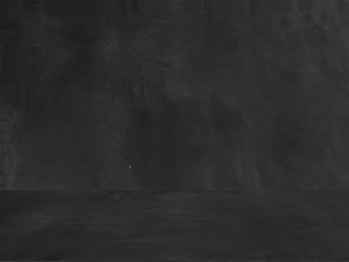
Crystal concept
Free Session for Preparation
Place : Boisar (Palghar)
Ragester your name : 8830979037 (Whatsapp)

Slide 4
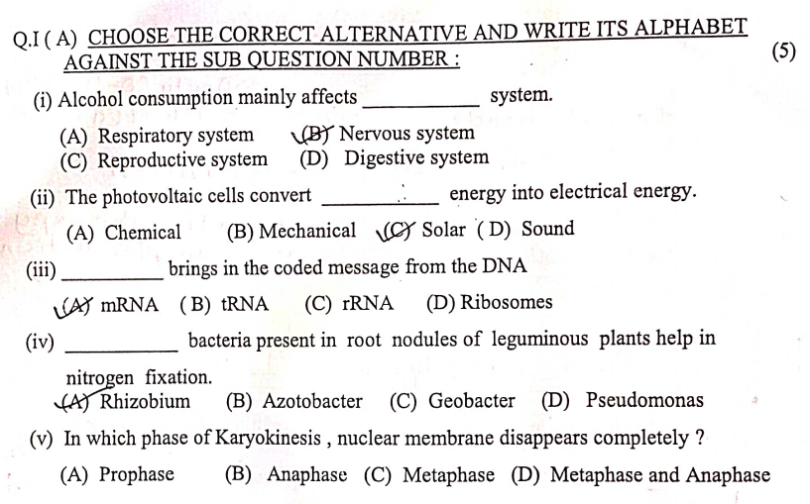
Crystal concept

Slide 5
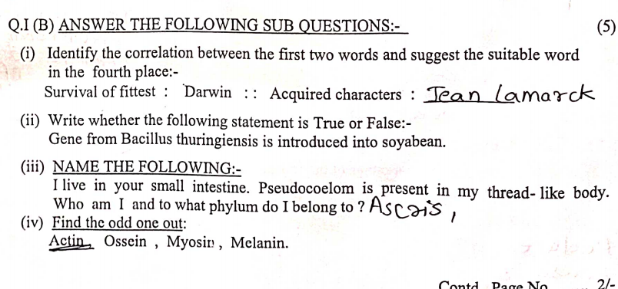
Crystal concept

Slide 6
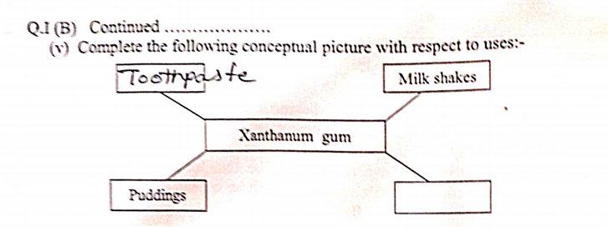
Crystal concept

Slide 7
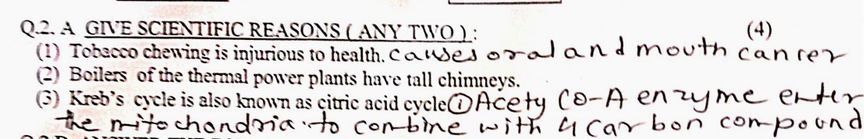
Crystal concept

Slide 8
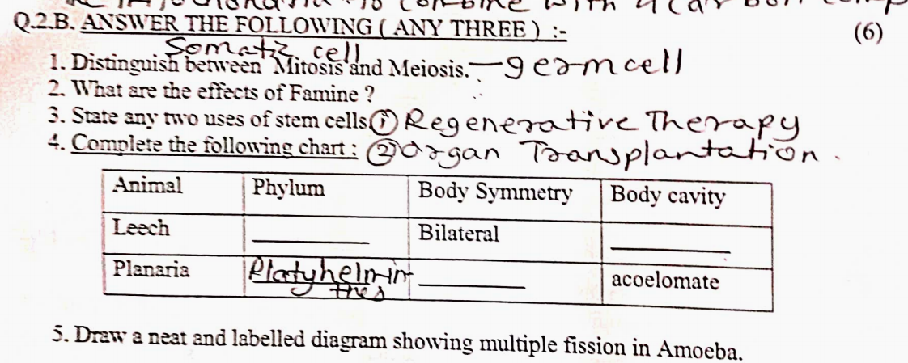
Crystal concept

Slide 9
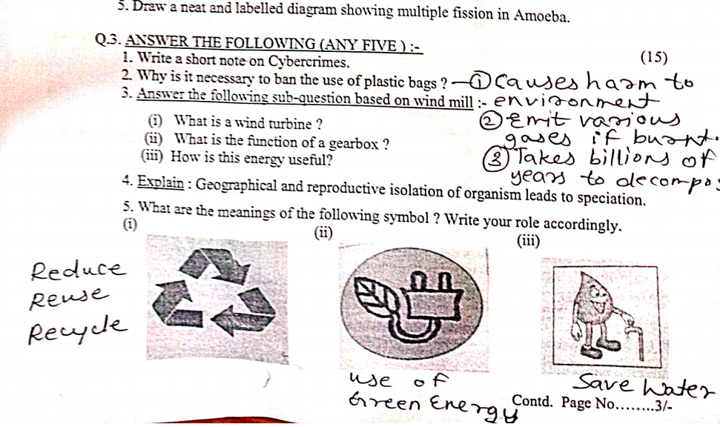
Crystal concept

Slide 10
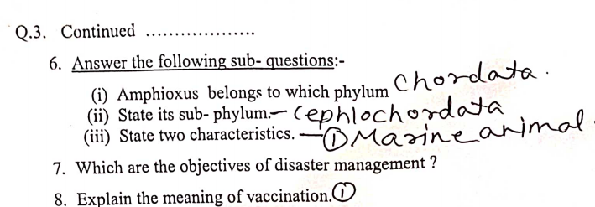
Crystal concept

Slide 11
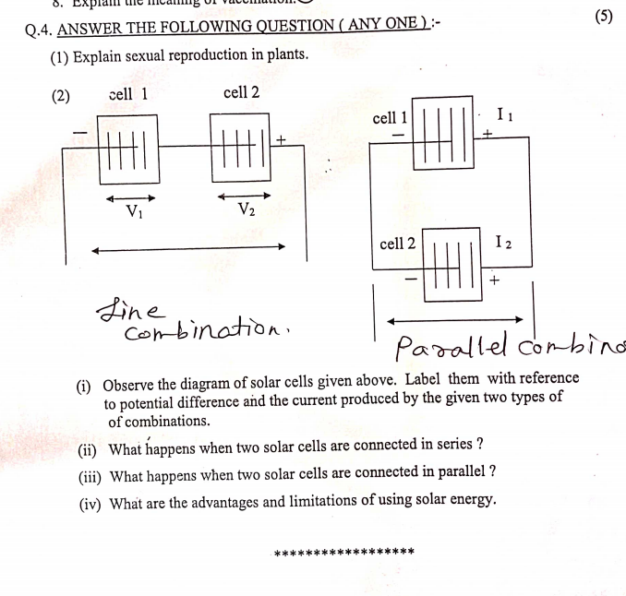
Crystal concept

Slide 12
Crystal concept
SUBSCRIBE

